Slide 1
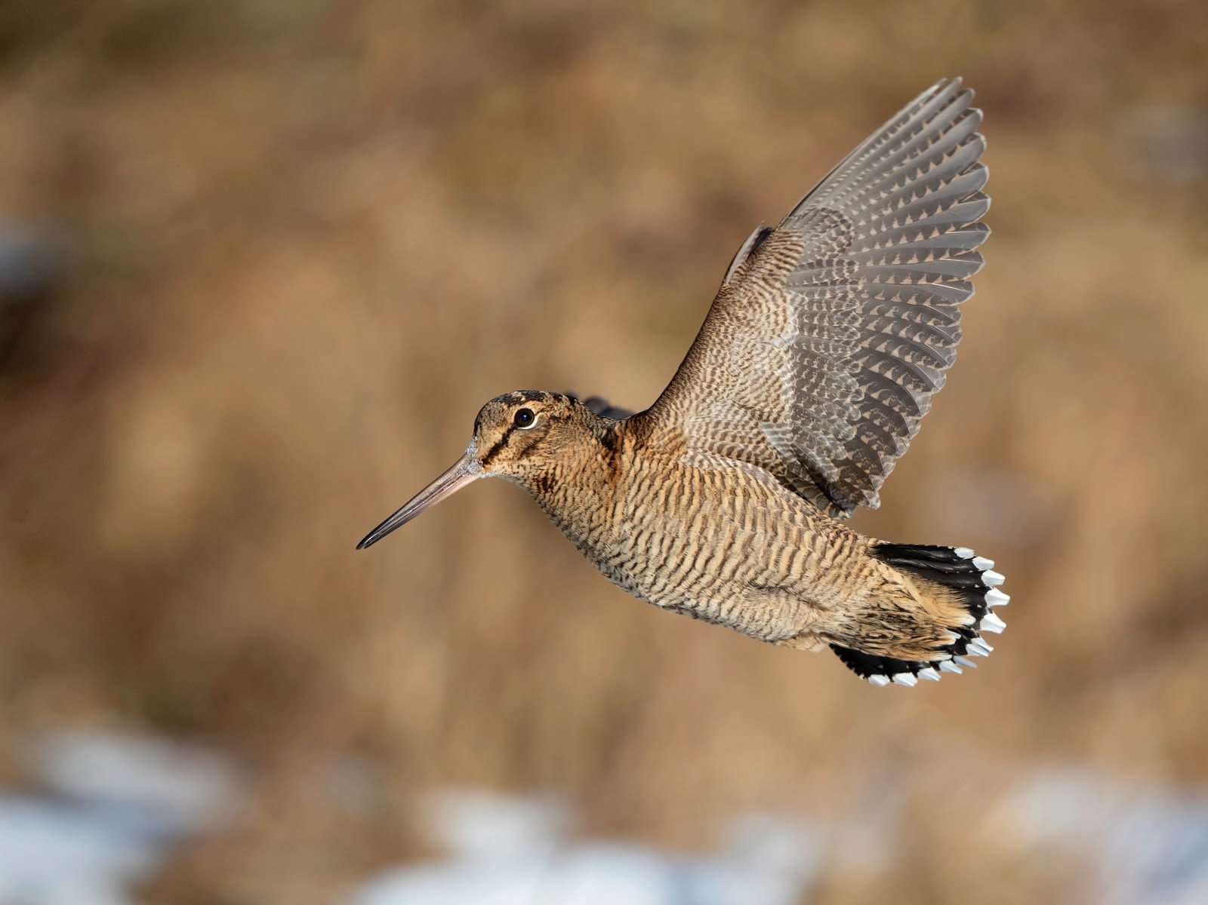
Are woodcocks shot in Switzerland local birds?
Pierre Mollet
Martin Grüebler
Steffen Oppel
Elizabeth Yohannes
Gilberto Pasinelli

Slide 2
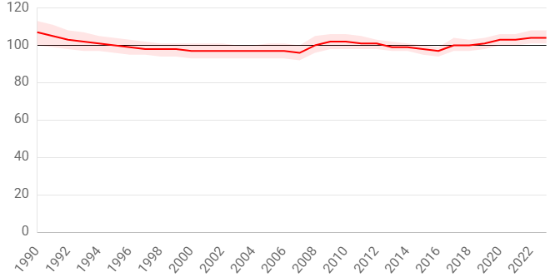
Background
woodcocks are shot in Switzerland (for ‘sport’) from 15. September to 14. December
woodcock breeding population more or less stable
Question: is hunting affecting local Swiss woodcock breeding populations?
Two data sets: (1) tracking data to estimate departure timing
(2) feather samples to infer likely origin of birds based on stable hydrogen isotope ratios

Slide 3
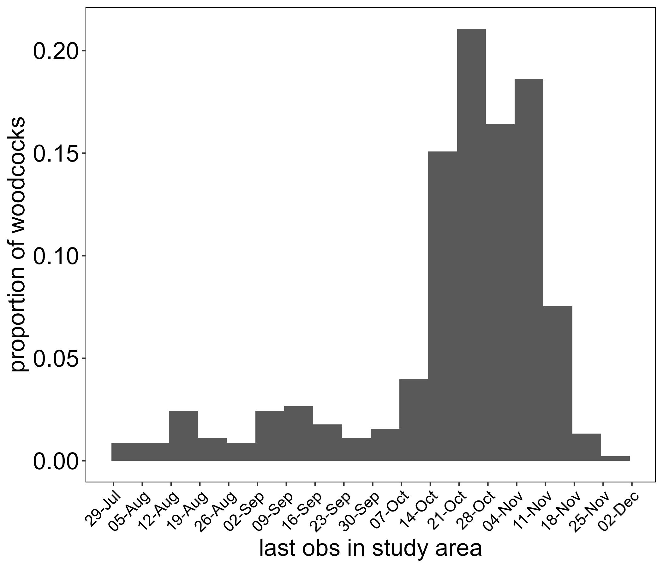
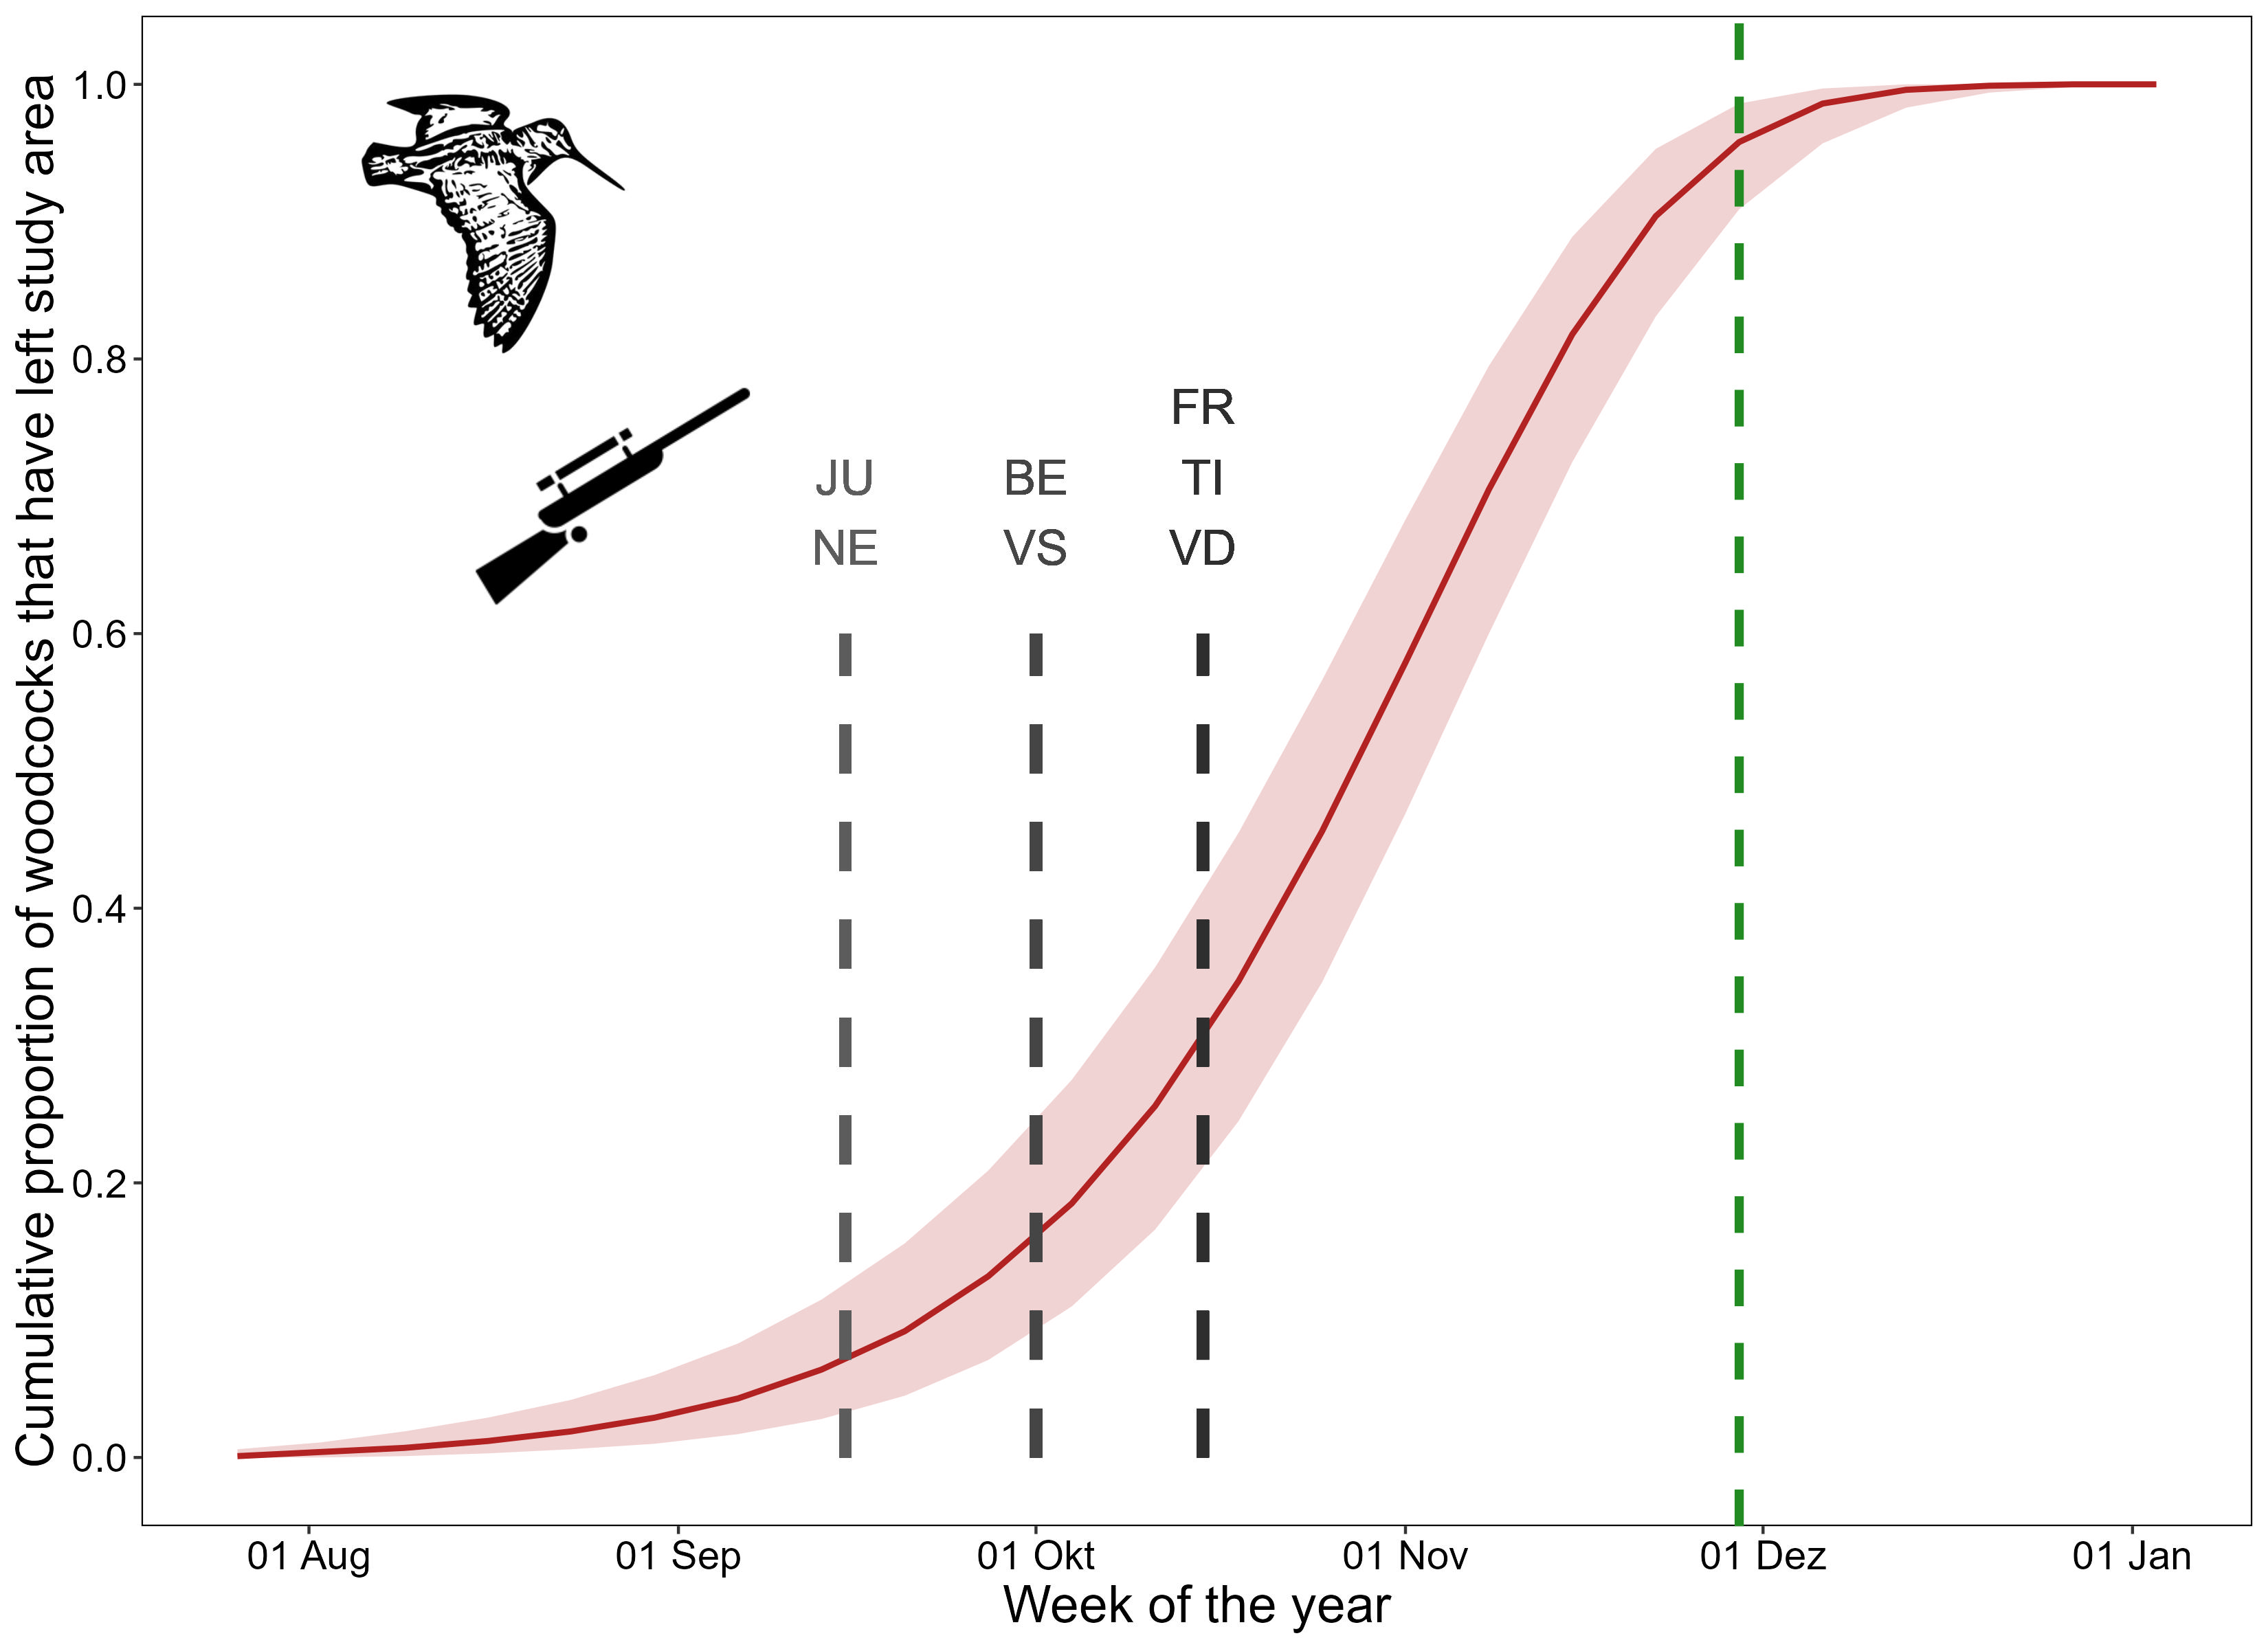
Results of departure analysis
based on VHF and GPS tracking of 432 individuals from Swiss forests
simple multi-event model to estimate departure timing
>50% of local woodcocks are still present during peak hunting season

Slide 4
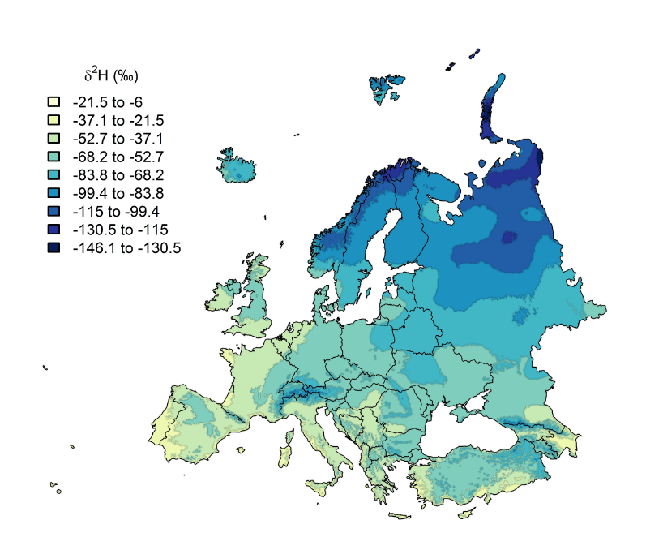
Background on geographic assignment with isotopes
geographic patterns of isotope ratios in rainwater due to global circulation processes
heavy isotope rains out -> higher elevations and more continental areas usually depleted in ²H_{rain} (more negative hydrogen isotope ratio δ²H_{rain})
this geographic pattern can potentially be used to infer origins of birds

Slide 5
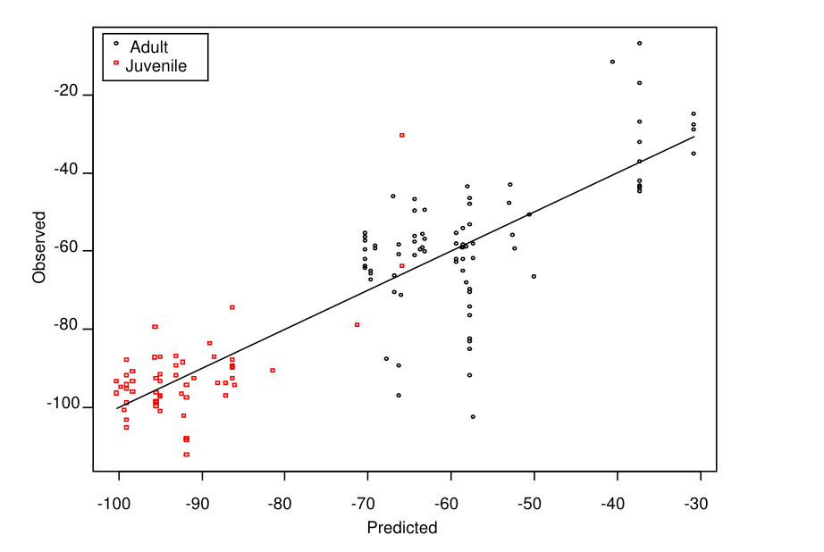
Some of the pitfalls… (there are more!)
rainwater isotope ratios do not necessarily reflect the dietary source for birds
timing of moult varies by individual and is often poorly known – but rainfall isotope ratios vary temporally
process of fractionation between diet and feather leads to alteration (usually depletion) of hydrogen isotope ratios

Slide 6
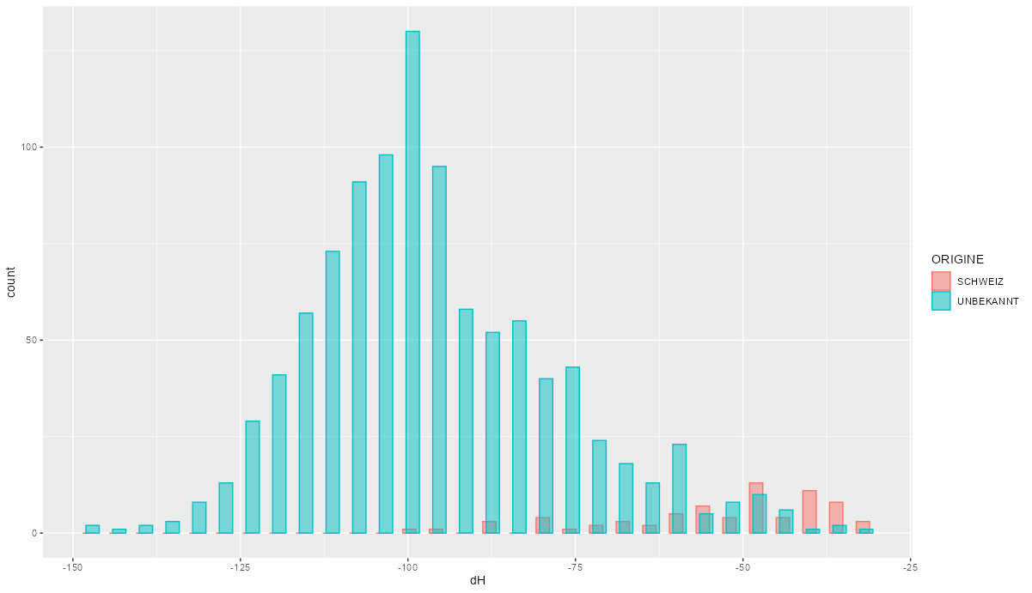
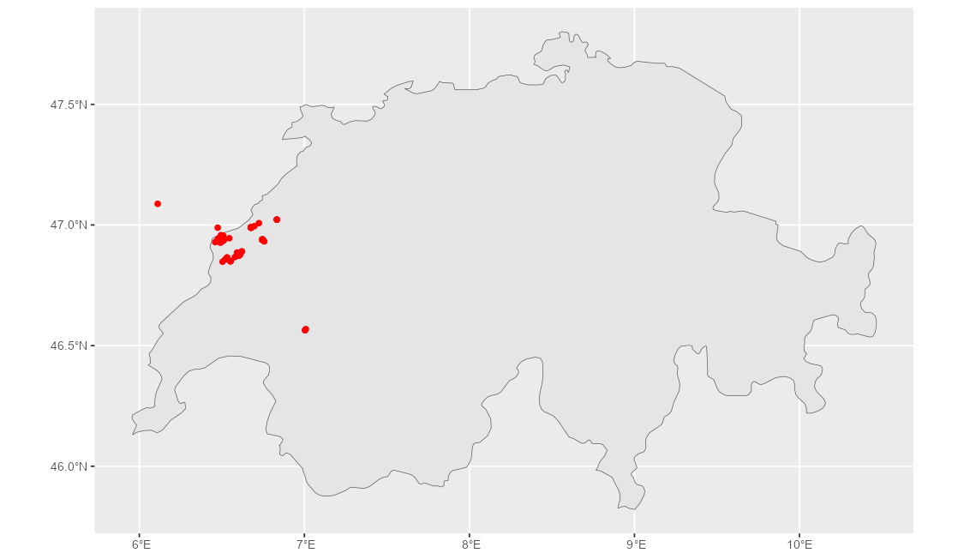
Are shot woodcocks of local origin?
we do NOT want to know where the woodcocks come from – only if they are local or not
constructed NIMBLE model to estimate probability of local origin
model uses informed priors and 72 feathers of known Swiss origin (all from NW Switzerland)

Slide 7
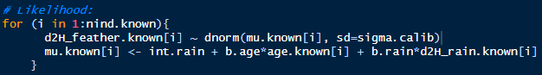
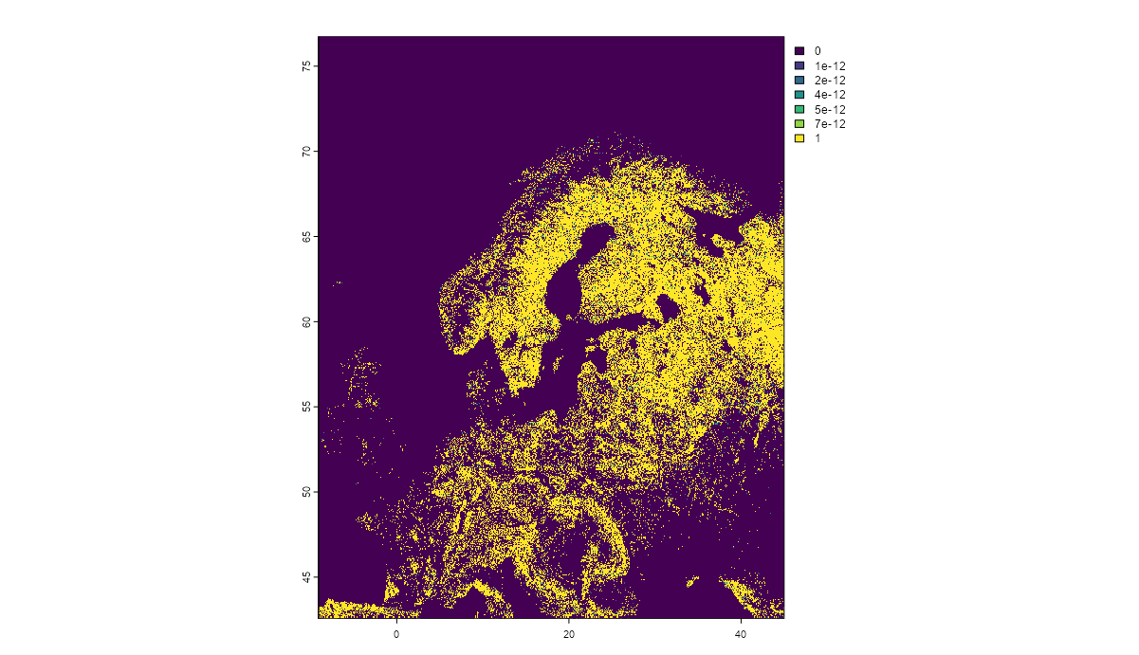
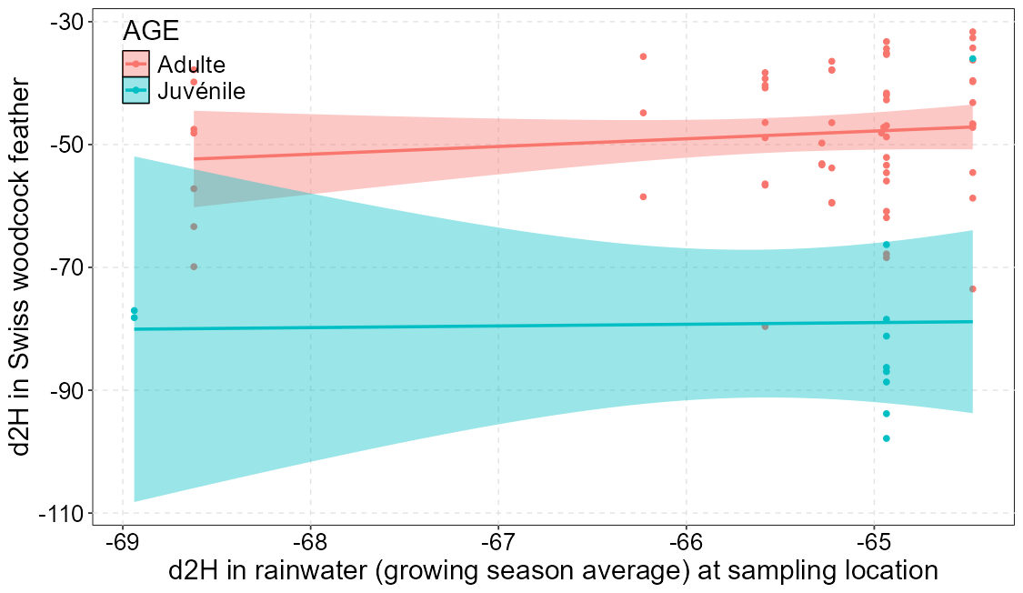
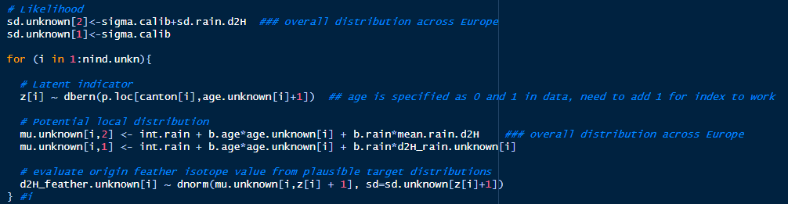
Structure of local origin model
use feathers of known origin to calibrate relationship between δ²H_{feather} and δ²H_{rain}:
overlay forest layer with woodcock range map and sample possible distribution of rainwater δ²H_{rain} from across the plausible woodcock distribution
for each shot woodcock, use the information on where it was shot to specify local δ²H_{feather} distribution (using equation from 1)
estimate the probability that the shot woodcock δ²H_{feather} comes from the local distribution (as opposed to the global background distribution):

Slide 8
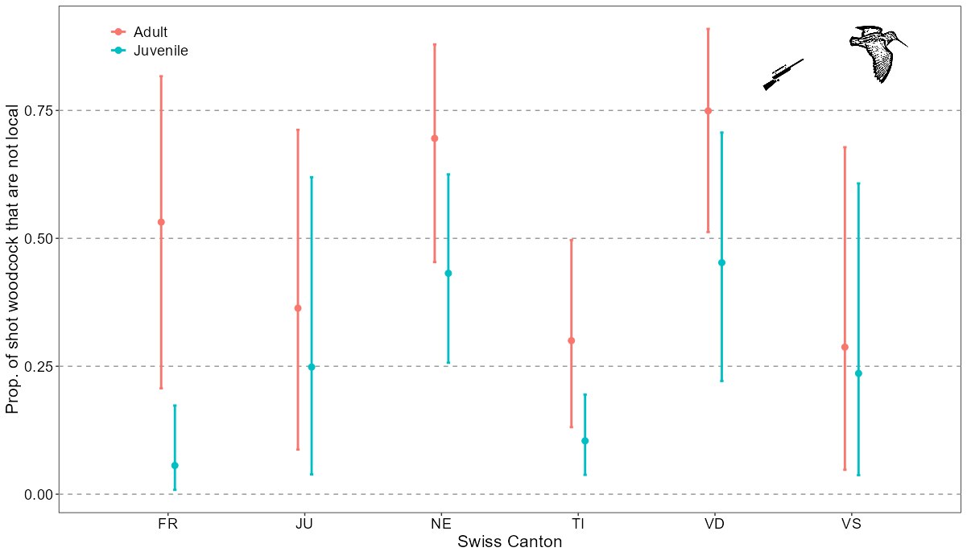
Output of local origin model
very large uncertainty in probability of non-local origin (range from 1% - 98%!)
most shot adults seem to be non-local (65.7%), juveniles less so (36.6%)
note that ‚local‘ includes all birds with similar feather isotope ratio – these birds could come from Germany or Austria where rainfall isotope ratios are similar to Switzerland

Slide 9
My questions:
is this model a reasonable approach to infer what we want to know?
should we estimate overall probability per age group (not by canton)?
does it matter whether we specify ‚prob.local‘ or ‚prob.foreign‘ in model?
how bold can we interpret these numbers?

